Slide 1
Getting Started with Data Science in R Deva O’Neil August, 2023

Slide 2
My use of Data Science Teaching (Physics, DSA, Python) Research (modeling)

Slide 3
Project analysis slide 2
A few things that
can be done with
Data Science
Modeling
Summary Statistics
Data
Visualization
Artificial Intelligence
Hypothesis Testing
Machine Learning

Slide 4
Project analysis slide 4
Fall 2023 Plan Data Science Workshops
Intro to Data Science
Tasks
.
Visualization and Statistics
Modeling, Regression
Hypothesis Testing
Today.
…
Intro to Data Frames in RStudio
Sept..
October.
November.
Resources

Slide 5
Project analysis slide 6
Why R
originally developed to teach statistics.
Big Data /
Machine Learning
R and RStudio are free
literate
programming
RStudio Cloud
Tidyverse and other packages allow for data wrangling

Slide 6
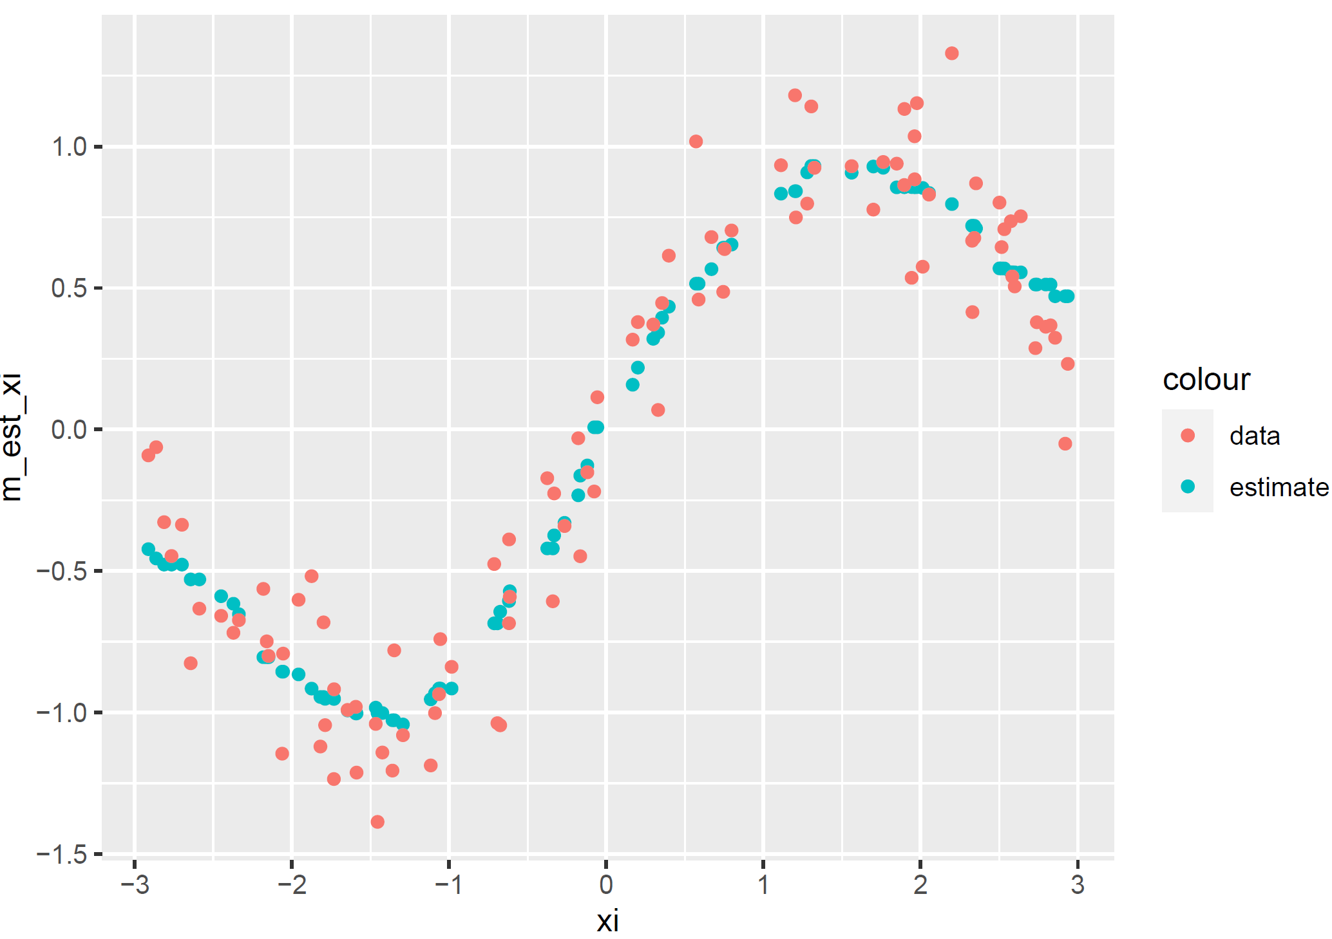
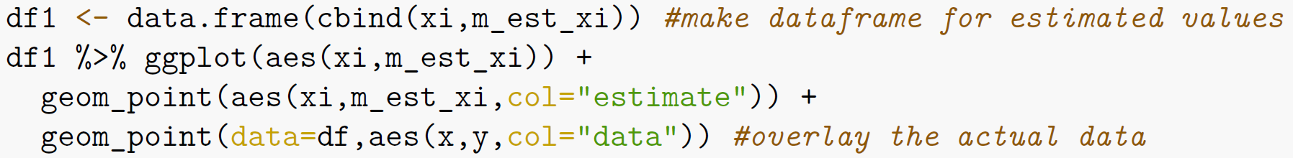
Project analysis slide 11
What R code
looks like

Slide 7
Project analysis slide 8
Data Analysis Software
POSITIVE
NEGATIVE
Handles large data sets
Literate programming
Packages (libraries)
Powerful tools for wrangling and filtering
Learning curve of coding
Need to install software or use cloud-based software
R (or Python)
Excel
Low barrier to entry
No programming
Limited tools

Slide 8
Project analysis slide 8
R Programming Styles
Base R
Tidyverse
Accomplish tasks with fewer characters
Built-in methods
Linear programming style
plot(x, y)
More powerful data wrangling tools
Uses data frames
df %>% ggplot(aes(x,y)) + ggpoint()

Slide 9
Let’s Get Started What tasks do you want to learn to do? github.com/devaoneil/R

